Slide 1
Introduction to ICHRAs

Slide 2






What is an ICHRA?
How it Works
Administration of an ICHRA
Case Study

Slide 3
What is an ICHRA?
Individual Coverage Health Reimbursement Arrangement (ICHRA)
An employer-funded, tax free health benefit used to reimburse employees for individual health insurance premiums.
Allows employers of any size to use pre-tax dollars to create a group health plan that pays for part or all of an employees’ individual health plan premiums.
Available as of January 1, 2020

Slide 4
What is an ICHRA?
Traditional Carrier Model
New ICHRA Model
Single Carrier
Carrier #1
Carrier #3
Carrier #5
Carrier #2
Carrier #4
4

Slide 5
Group vs. an ICHRA
Health plan comparison chart
Traditional Group Benefits
ICHRA Benefits
Annual renewals are cumbersome
Human resources have to be heavily involved in the administration and management of the employee benefits
Employees have limited choices of coverage options
Dependents have to receive the same benefits as the employee
There are limited plan choices, often only one or two plans
Human resources no longer has to manage or administer benefits for employees
Employees can find plans that are right for them, and their dependents
Each employee can pick their own plan, it’s no longer a one size fits all health plan
Depending on the county, employees can choose from many carriers, and 20+ plans

Slide 6
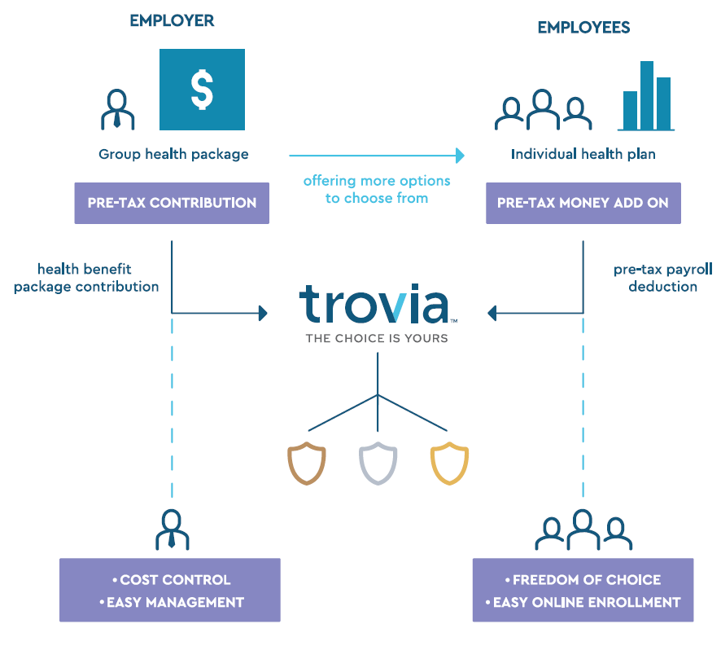
A 401(k)-style health benefit
COSTS
Costs are predictable for you, as you have complete control over the pre-tax contribution amount.
OPTIONS
More options for your employees to select from, providing them freedom to shop the individual marketplace for coverage that better suits their needs.
FREEDOM
Employees can take the individual health insurance with them if they leave the company.
BONUS
If an employee doesn’t buy insurance or doesn’t use all the money, you get to keep it and no plan participation minimums to worry about.
ICHRA Plans
Notes:
When the defined contribution 401(k) appeared on the retirement scene in the early 1980s, employers embraced it as a way to replace or supplement traditional defined benefit pensions (characterized by their often higher costs, unpredictable expenses, and limited employee choice). With an ICHRA, you can embrace the defined contribution approach with health insurance. Defined contribution health benefits offer an alternative to the traditional defined benefit group health plans and open the doors to the individual health insurance marketplace, which in turn eliminates the guessing game around which plans will meet the needs of all your employees. Like 401(k) plans which offer a variety of investment options, an ICHRA provides employees with a vast array of carriers and plan design options to consider. ICHRAs shift the choice and responsibility from the employer to the employee – it is the employee who determines where and how to spend the employer’s pre-determined contributions. Because of this, the decision-making is in the hands of the employee, which encourages them to be more informed health care consumers.

Slide 7

The US Treasury department expects that in about five years, 800,000 employers will offer an ICHRA, and more than 11 million employees will have an ICHRA.
- Attributed to the Center for Medicare
& Medicaid Services
Notes:
Stats: 2018 average carrier per state: 2.5
2020 average carrier per state: 4.5

Slide 8
ICHRA eligibility
To be covered under an ICHRA, employees (and any family members) must be enrolled in an individual major medical plan, or Medicare.
For premiums of individual medical coverage to stay as a reimbursable expense under the ICHRA
  All individual medical plans available in the employees’ zip code must be offered
  Enrollment is the employee’s responsibility
  Benefit selection is the employee’s responsibility
Employer involvement in benefit selection runs the risks of policies being viewed together as an employer sponsored group health plan

Slide 9
ICHRA Qualified Plans
Allowed
Allowed
Not allowed
Commercial
Individual/family plans
Catastrophic ACA plans for under 30
Student health insurance
Public
Medicare plans
Association plans
MEWAs
TRICARE
Short-term limited duration plans STLDI)
Fixed-indemnity plans
Health-care sharing ministries

Slide 10
Question?
If an employee is offered an ICHRA, are they still eligible for the premium tax credit?
It depends. Should the ICHRA benefit offered by the employer be deemed unaffordable under the definition laid out by the Affordable Care Act, employees may waive enrollment in the ICHRA and may claim the premium tax credits for use through a federal or state-based health insurance exchange.

Slide 11

Employer benefits
Eliminates the guesswork of which plans meet the needs of all (or most) employees
Gives a competitive advantage in recruiting and retaining good people
Enables cost predictability
Removes some of the burdens of managing a health plan and unexpected health risks, off of the employer
Reduces the administrative stress of handling renewals
No participation minimums to worry about
If an employee does not buy insurance or does not use all of the ICHRA money, the employer keeps the money
Notes:
I’m hoping you are already thinking about ways this type of program could benefit your employer groups. Let’s consider some of the ways that an ICHRA benefits the employer.
It eliminates the guesswork of which plans meet the needs of the majority of the employees. Pressure from selecting which plans, which carriers, or which networks best meet the needs of the employees is eliminated through offering an ICHRA.
It enables cost predictability, because YOU are structuring the HRA contribution. It allows for very detailed budget panning.
It removes some of the burdens of managing a health lan and the underlying health risks that could come up. We’ve probably all experienced those groups that get into a self-funded scenario and then an unexpected health risk comes up, so the strategy needs to be changed, and you are back at the drawing table again. You may have an Experience Rated group that has had bad claims experience and is seeing higher rates as a result.
It can also reduce the administrative stress that can come with handling renewals, the time commitment to evaluate different pan designs, different networks, etc., holding open enrollment meetings, educational meetings on the plans that were selected; those get reduced and it simplifies it down to “let’s talk about your healthcare budget and the best way to strategize the contribution amounts, so employees can choose plans that best fit their needs.
There are no participation minimums to worry about.. You’ve probably experienced a group that has either very high turnover, or very low participation, and some carriers, like BCBSM, will put a premium load on a group that has low participation, or they may not even provide an option to quote and provide rates because of the low participation.. That is all eliminated with the offering of an ICHRA.

Slide 12

Employee benefits
Presents more plan options – gives the freedom to choose plans that better suit their needs and price range
Provides tax advantages – because reimbursements do not count toward the employees’ taxable wages
Provides plan portability – employees can take the insurance with them if they leave the company.
Provides privacy – health claims data is not shared with the employer
Creates trust and sense of care – When employees see their employer taking care of them, by offering funds to help pay for healthcare coverage
Notes:
Employees can also experience great benefits from an ICHRA offering.
If the premium is more than what the employer is contributing, those contributions can be set up on a pre-tax deduction from their payroll.
Portability: significant, even pre-COVID, we see employees changing jobs frequently, and when they do this they have to determine – do I take COBRA? Do I buy an individual plan? Then I need to shop my options again. Especially with some of the changes due to COVID, like employees being furloughed or laid off, an ICHRA can provide an option that the employee can take with them when they leave the company, and they don’t have to shop. The employer would simply change the billing option so the employee will begin receiving their billing at their home, and the employee can continue making the premium payments with no disruption in their benefits.
Sense of trust and care: we are seeing ICHRAs being utilized in situations where employees have never been offered benefits before. Maybe the employer has a large segment of part time employees, and they may be very valuable, but not eligible for a group benefit. This is also a great way for a group that has never offered benefits to take a simple step into it – again, creating that trust and sense of care for their employees. Employees feel that and an ICHRA is a great way to accomplish that.

Slide 13
ICHRA key features
Available to groups of all sizes
An ICHRA can satisfy the requirements of the Applicable Large Employer (ALE) mandate
11 class types available for setup under the ICHRA; an example - hourly vs. salary
Contribution levels may differ based on family size and/or age groups
Employers may offer both an ICHRA and traditional group health insurance plan, however not to the same class of employees
ICHRA reimbursable expenses include premiums for individual major medical, Medicare coverage and section 213d expenses

Slide 14
Plan Design
Employer can choose to structure the eligibility and contribution criteria using 11 employee classes defined by the ICHRA regulations:
Full-time employees
Part-time employees
Seasonal employees
Salaried employees
Non-salaried employees (such as hourly)
Employees covered by a particular collective bargaining arrangement (different bargaining units can be separate classes)
Employees who have not satisfied a waiting period
Temporary employees of staffing firms
Non-resident aliens with no US-based income
Employees working in the same insurance rating area (geographic location, state or region)
Any combination of two or more of the above

Slide 15
Eligibility requirements
There are a few rules to ensure the offerings
do not discriminate, including:
Employers must offer the same amount of reimbursement to all employees in a class.
Employers cannot offer an ICHRA to an employee who is also offered a group health plan. However, an ICHRA may be offered to one class, such as part-time workers, and group health plans to another, such as full-time.

Slide 16
Eligibility considerations
Should an employer offer a group health plan to a class of employees, class size limitation guidelines must be followed if the employer uses any of the following classes:
Full-time employees
Part-time employees
Salaried employees
Non-salaried employees
Employees working in the same rating area
In these cases, classes must be larger than: (Rounded down to the nearest whole number)
Ten employees, for an employer with fewer than 100 employees.
Ten percent of the total number of employees, for an employer with 100-200 employees.
Twenty employees, for an employer with more than 200 employees.
Also, through a new hire rule, employers can offer new employees an ICHRA while grandfathering existing employees in a traditional group health plan.

Slide 17
Contribution Strategies
Employers define the monthly amount they want to contribute to the ICHRA; it can be as little or as much as they want. With an ICHRA there are no minimum or maximum contribution limits.
Contribution examples:
    Defined Contribution by giving all employees $$$ per month. May vary by class and status.
    Define the Employer Contribution by “benchmarking” to a plan.
    Define the Employee Contribution by “benchmarking” to a plan.
Individual market plans for older people typically cost more, so employers may elect to offer higher contribution allowances to older employees. Contribution allowances must be structured using a 1:3 ratio from the youngest to the oldest employee. An employer, for example, may offer a 24 year-old $100 per month and a 64 year-old $300 per month.

Slide 18
Why is there hesitation to offer an ICHRA?
ICHRAs are new, and groups and brokers need education about this new option.
Uncertainties of who is a good fit.
Concerns about compliance and administration of an ICHRA

Slide 19

Groups that Fit
Small Groups (<50)
Large Groups (50+) with higher claims/rates
Groups with participation issues
Groups with contribution concerns
Associations, Co-Ops, Franchises, etc.
Industries such as hospitality, entertainment, seasonal, high-turnover, etc.

Slide 20
Administration of an ICHRA
It is possible for an employer to administer an ICHRA, keeping in mind that it requires management of a number of important components, including:
Written Plan Document
Summary Plan Description (if subject to ERISA)
COBRA Administration
Compliance with general HRA and group health plan requirements
Contribution Allowance Evaluation
Reimbursement Mechanism
Record Keeping
Tax Reporting
HIPAA privacy and security compliance
The items listed, and other administrative tasks, are often time consuming and labor intensive. Self-administration may also leave an employer vulnerable to liability and legal action. Following are a number of areas where an outside administrator may be of great value and service.

Slide 21


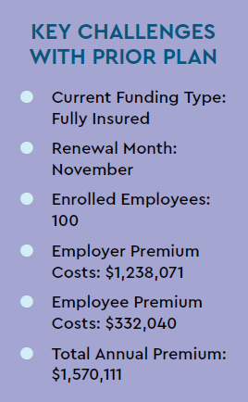
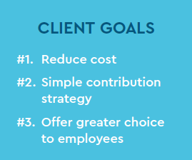
Trovia
Notes:
Case study may want to be hidden in a CE situation…??

Slide 22
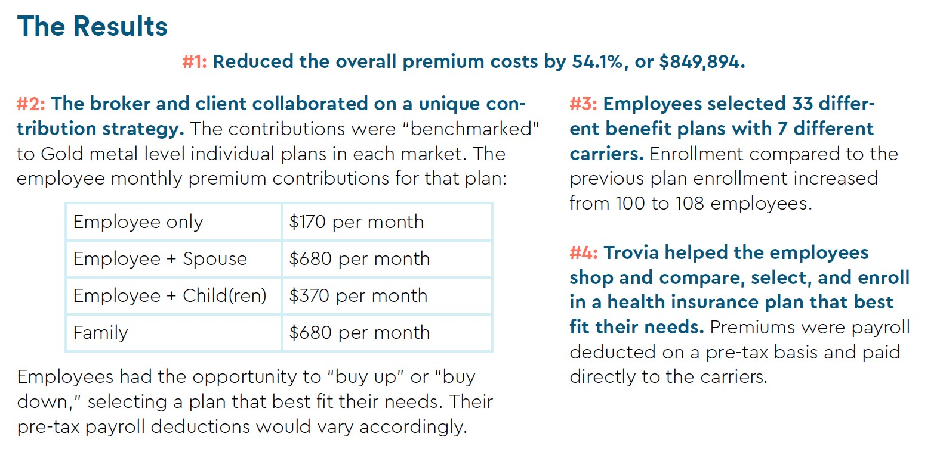
Trovia
Notes:
NOTES FOR KATELIN: #4 needs to be eliminated, because it is Trovia-specific, and not all vendors have the premium pre-tax option.

Slide 23
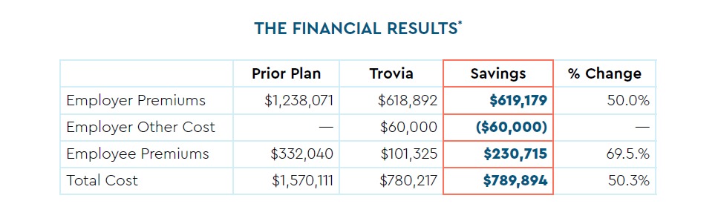
Trovia
Notes:
NOTES FOR KATELIN: Change “Trovia” column to say “ICHRA”

Slide 24
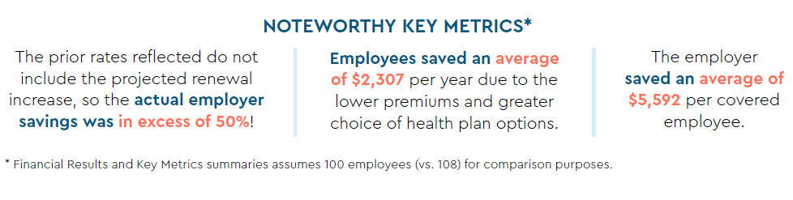
Trovia

Slide 25
Questions?
If you are interested in receiving more information about ICHRAs or ICHRA administration, please contact:
Tammy Deur – 616.970.7049
tdeur@tggsolutions.com
or
Scott A. Davis – 616.304.9300 sdavis@tggsolutions.com
This material is for general information purposes only. This material is not to be considered or taken as legal, tax, benefit, or human resources advice. Regulations change over time and can vary by location and employer size, among other factors. Nexben and Trovia do not guarantee any form of access, eligibility, or coverage. Consult a licensed broker, human resources certified expert, or attorney for specific guidance. Nexben and Trovia services are subject to terms and conditions.
Trovia™ and Nexben™ are trademarks of Nexben, Inc.
Notes:
ACTION ITEM: I recommend also including sales team member contact information. Interested in getting more information on ICHRAs or ICHRA administration?

